Slide 1
Kangaroos from Poznań (Poland)
Presented poem (song)
„About little cat”

Slide 2

About little cat ☺
He comes so softly
that no one hears him
and so mice are very
afraid of him.

Slide 3
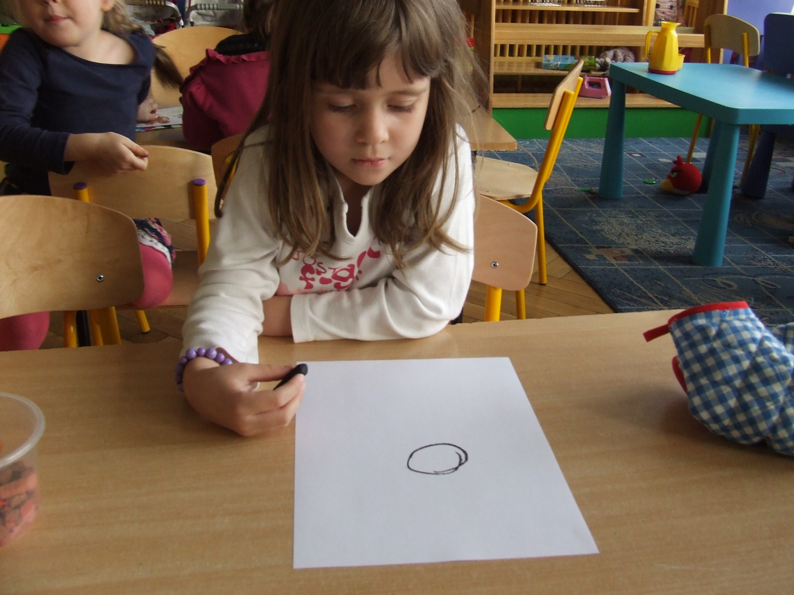
Small circle,

Slide 4
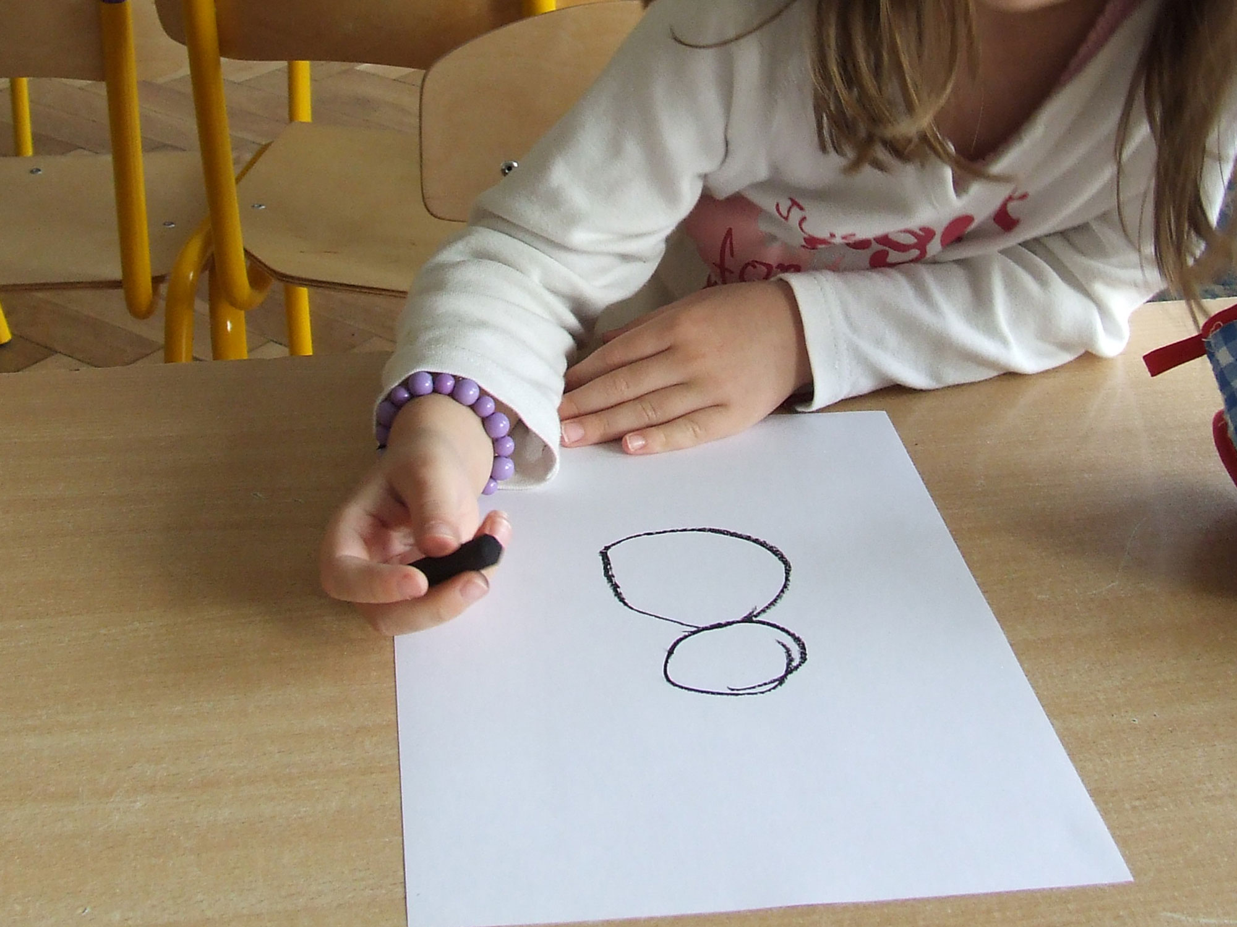
big circle,

Slide 5
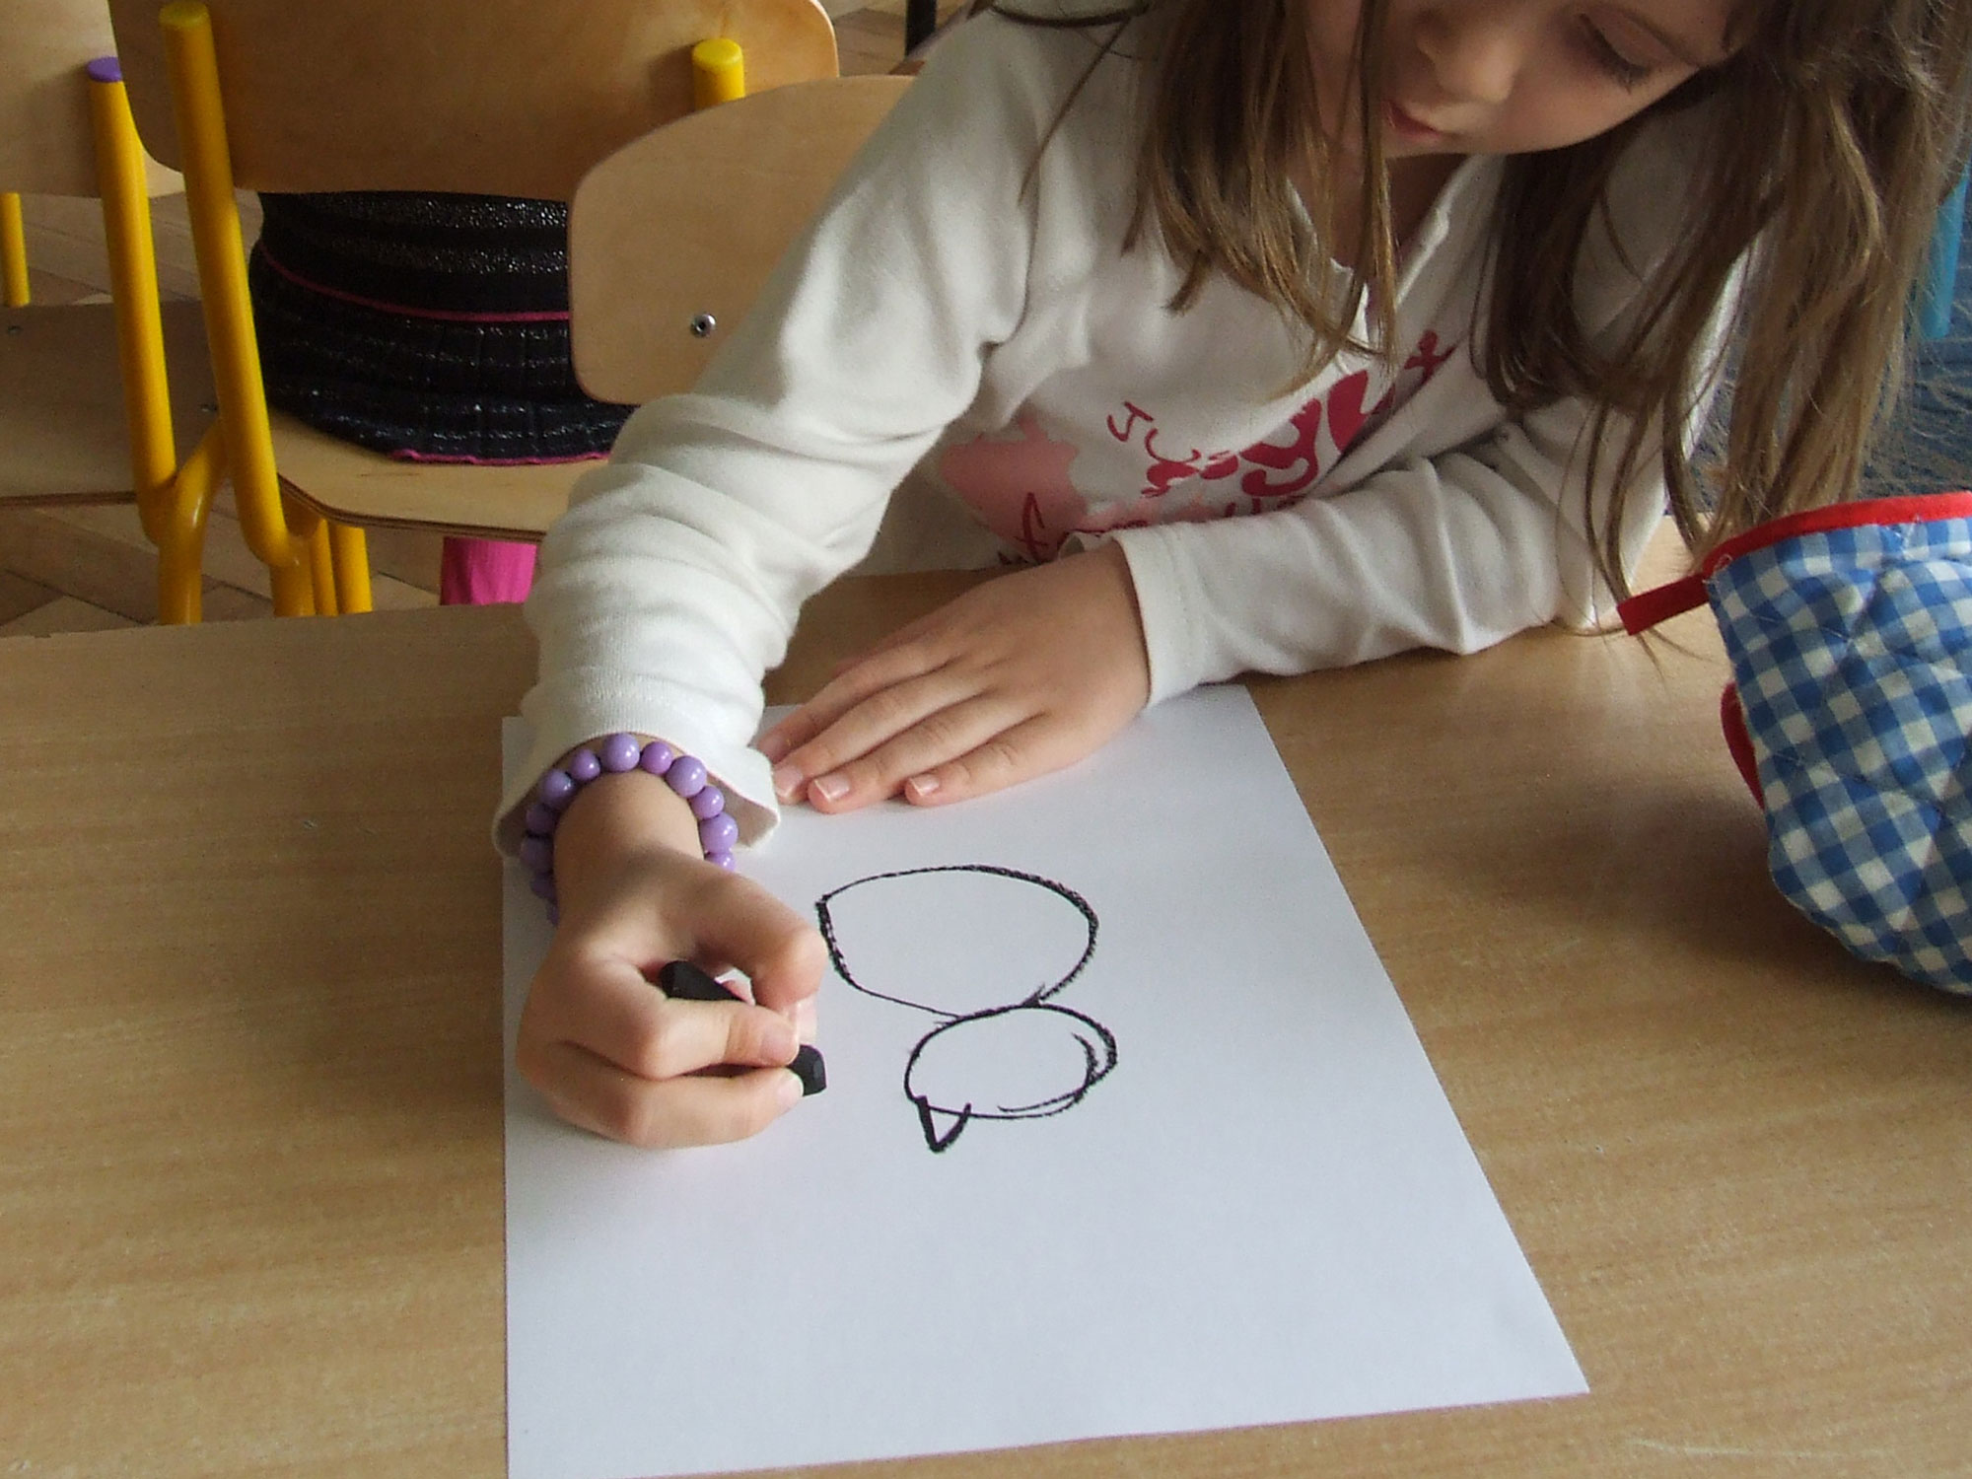
one ear

Slide 6
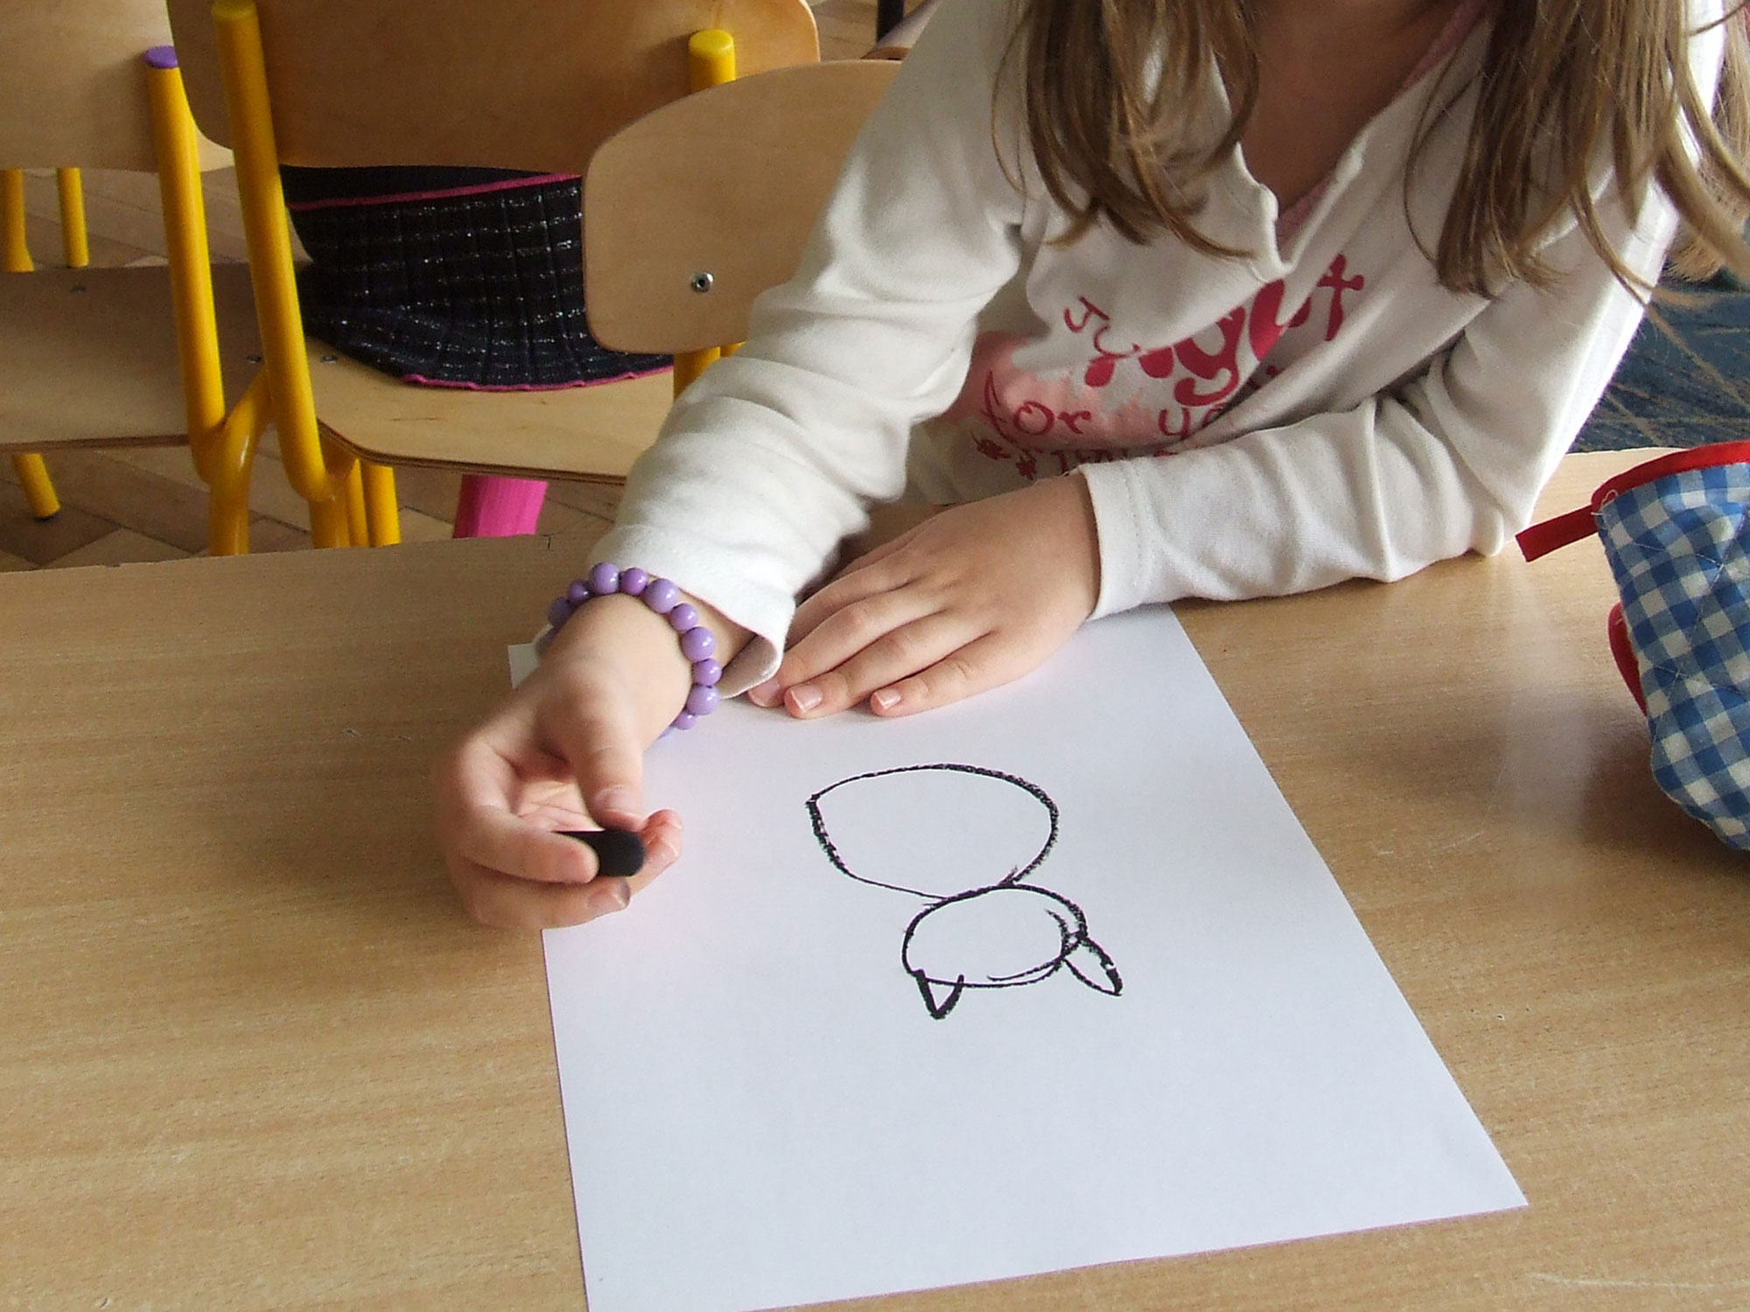
and the second,

Slide 7
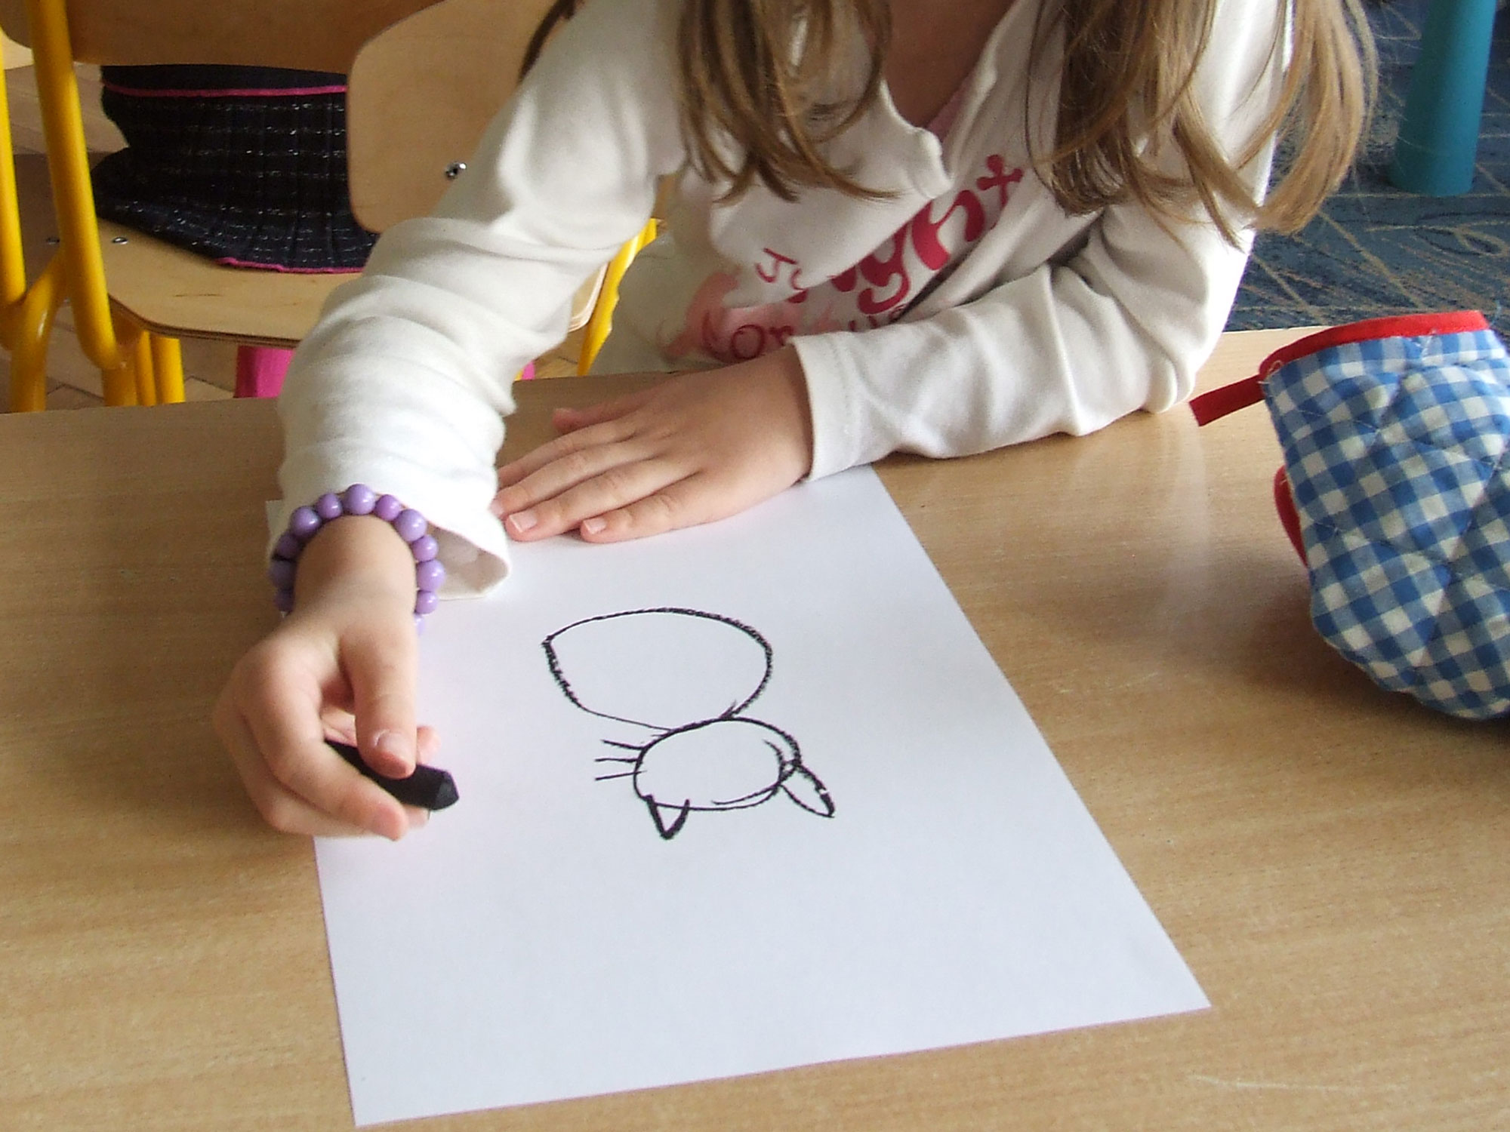
three whiskers on the one hand,

Slide 8
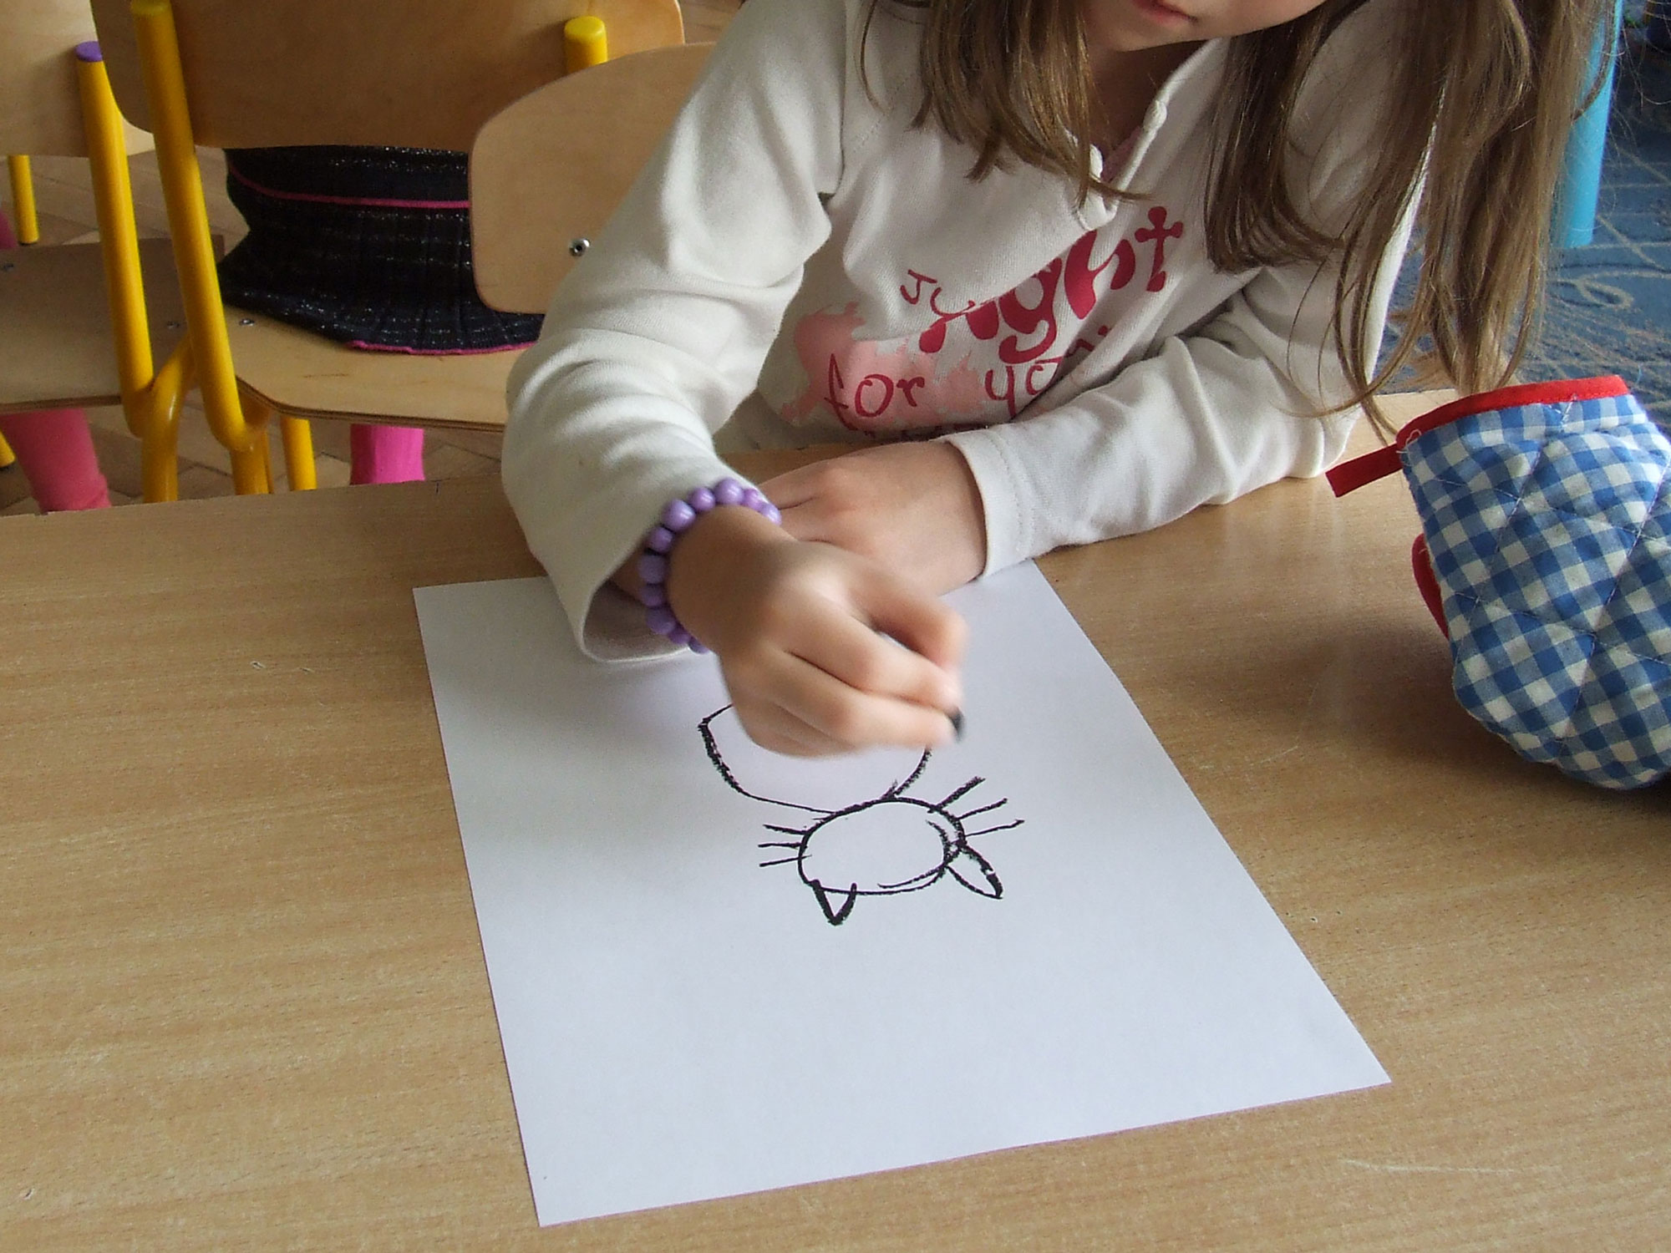
three whiskers, on the other hand,

Slide 9
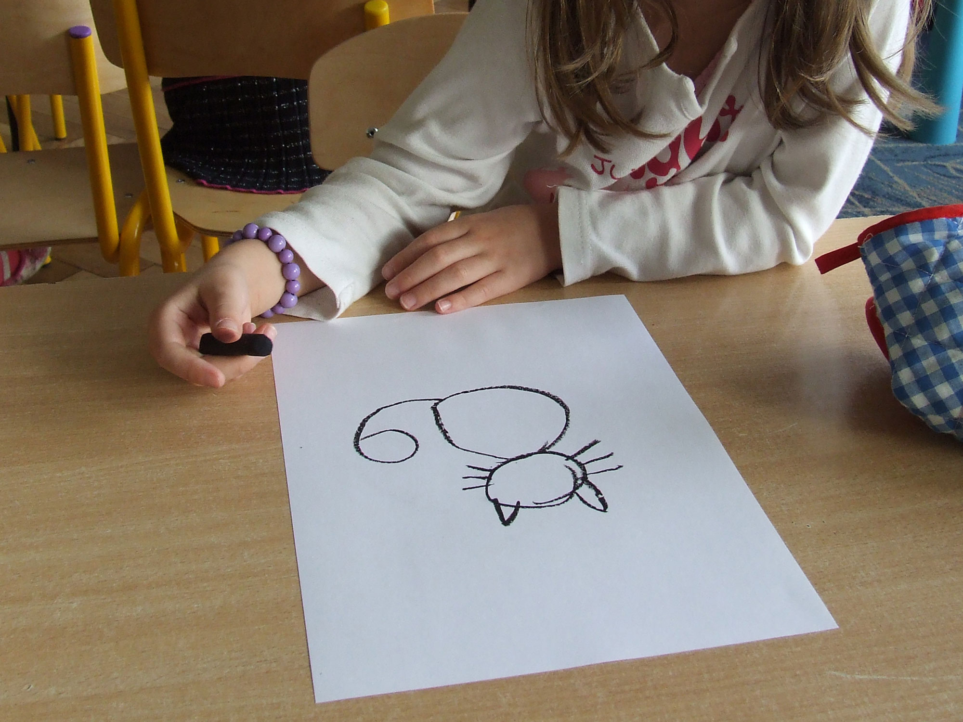
and curled tail,

Slide 10
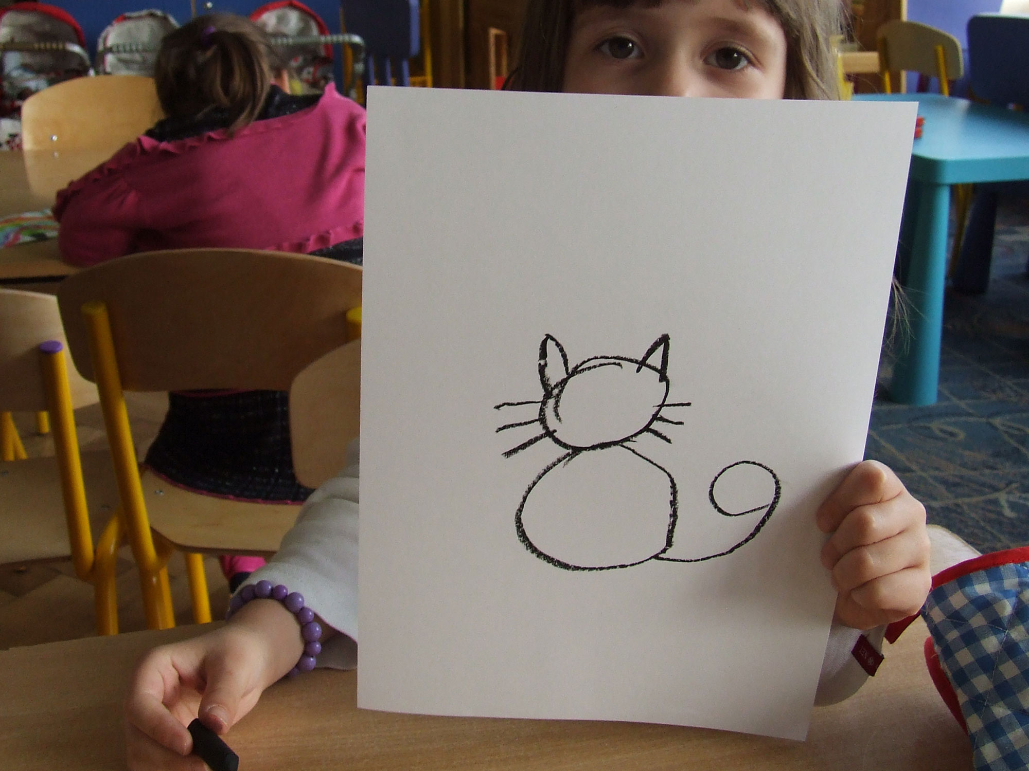
is a kitten rear reversed.

Slide 11
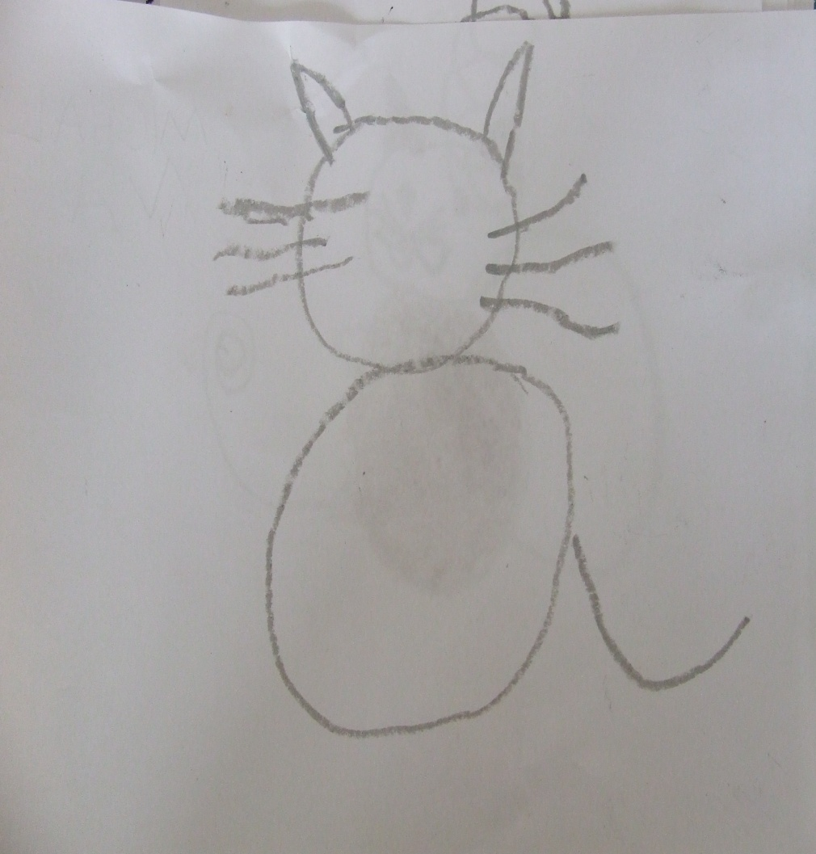
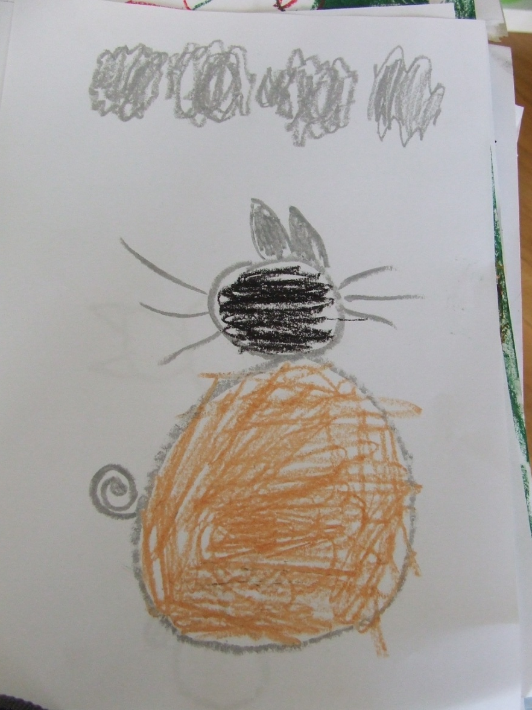

Slide 12
About little cat☺
He comes so softly
that no one hears him
and so mice are very
afraid of him.
Small circle, big circle
one ear and the second ,
three whiskers on the one hand,
three whiskers, on the other hand,
and curled tail,
is a kitten rear reversed.

Slide 13
Bye, bye ☺!
See you later ☺

